Slide 1

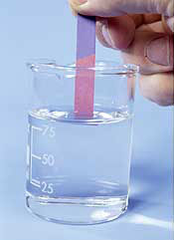
The Inquiry Brief Litmus Test
Developed by Nancy Fichtman Dana based on the book Digging Deeper into Action Research:
A Teacher Inquirer’s Field Guide (2013)

Slide 2
Welcome to the
Inquiry Brief Litmus Test!
Engagement in action research (also known as inquiry) is an exciting component of IPLI.
Action Research is systematic, intentional study by principals of their own practice.
The process begins with the articulation of a wondering, a burning question that you, an IPLI administrator, have about your practice.

Slide 3
Once IPLI administrators develop a question, the next step is to develop a plan for their inquiries.
This plan often takes the form of “an inquiry brief.”

Slide 4
An inquiry brief is a one-two page outline for your action research plan. It usually includes the following:
  A paragraph that provides the background for your inquiry and ends with a purpose statement.
  A statement of your Question/Wondering(s).
  An articulation of any action you plan to try.
  An articulation of the ways you will collect data.
  A timeline for how your study will unfold.

Slide 5
Similar to the wondering litmus test, the inquiry brief litmus test in this tutorial consists of a series of questions that will help you refine your plan for action research until you feel you have established the best possible route for your inquiry journey.

Slide 6
Begin by placing a hard copy of your inquiry brief by your side as you proceed through this tutorial.
You can edit your plan and make notes to yourself on this document as you answer each question in the litmus test.

Slide 7

Litmus Test Question One
Are you utilizing multiple forms of data to gain insights into your wondering?

Slide 8
Throughout the litmus test questions about wondering development, we’ve been reminded over and over again about the complexity inherent in the act of being an administrator as a primary reason engagement in action research is such an important endeavor for principals to do in the first place!
Principals inquire because they want to untangle some of that great complexity inherent in their daily work and engage in a continuous cycle of improvement, truly becoming the best educators they can be!

Slide 9
As principals work to untangle the complexities of their work, they know that any one data source, no matter what that data source is and how much stock others put into that data source (such as scores on a standardized test), can only provide a limited perspective on what is happening in their schools and their role as instructional leaders within them.
Hence, most principal action researchers choose to utilize more than one source of data to gain insights into their wonderings.

Slide 10


Before continuing with the litmus test, look carefully at your inquiry brief.
Have you incorporated more than one data collection strategy into your inquiry plan?
If not, consider the multiple possibilities that exist for data collection listed on the next slide and add additional data collection strategies to your plan that will inform your research.

Slide 11
Possible Data Collection Strategies
Student Work
Field Notes/Anecdotal Notes/Running Records
Documents (such as lesson plans, curriculum guides, school policy, textbooks, IEPs, district memos, parent newsletters, progress reports, teacher plans books, and correspondence to and from teachers, parents, district level administrators, and specialists)
Interviews (individual and group)
Digital Pictures
Video
Reflective Journals
Weblogs
Surveys
Quantitative Measures of Student Achievement (standardized test scores, assessment measures including progress monitoring tools, and grades)
Feedback from Colleagues (could be obtained through your regional cohort group work and/or lead team)

Slide 12

Litmus Test Question Two
Does one of the forms of data you will collect include literature and/or have you already utilized literature to frame your wondering?

Slide 13
Although we often do not think of literature as data, literature offers an opportunity to think about how your work as an IPLI adminstrator is informed by, and connected to, the work of others.
No one serves as an administrator in a vacuum. . .

Slide 14
When principals inquire, their work is situated within a large, rich, preexisting knowledge base that is captured in such things as books, journal articles, newspaper articles, conference papers, and Web sites.
Looking at this preexisting knowledge base on administration can informs your study.
Literature is an essential form of data that every action researcher should use as to be connected to, informed by, and a contributor to the larger conversation about educational practice.

Slide 15
Before continuing with the litmus test, look carefully at your inquiry brief.
Have you incorporated the exploration of literature into your plan?
If not, look for some literature on your AR topic. Ask your IPLI Mentor, members of your regional cohort, and/or the IPLI leadership team for recommendations of literature that connect to your action research topic and might inform your work. You may also utilize a search engine such as Google Scholar to find research related to your study.

Slide 16
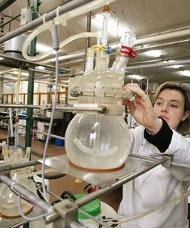
Litmus Test Question Three
Is the design of your study “experimental?”

Slide 17
When educators hear the word “research,” one image that is often conjured in their minds is that of a scientist in a lab coat, formulating hypotheses and setting up comparison groups – one to receive a “treatment,” and one to remain “the control.”

Slide 18
Because the word “research” carries so much baggage with it, it is not uncommon for first time action researchers to be drawn to traditional experimental study designs in the early stages of developing a plan for their research, and think their research plans need to include a “control” and “experimental” group component.

Slide 19
Yet, rarely does it make sense for an action research study to take an experimental form, as action research is generally about capturing the natural actions that occur in the busy, real world of your school.
In addition, by and large, a single principal’s school usually is not a ripe place to design an experimental study since the sample size utilized in the study generally would not be adequate to indicate any statistical differences, and any one treatment variable would almost be impossible to isolate from intervening variables.

Slide 20
Finally, one would need to question the ethics of providing a potentially beneficial “treatment” to some but not to all.

Slide 21
Before continuing with the litmus test, look carefully at your inquiry brief.
Is your study designed with a “comparison” and “control” group?
If so, try reframing the study design to capture natural actions that are occurring in the busy, real world of your school.

Slide 22
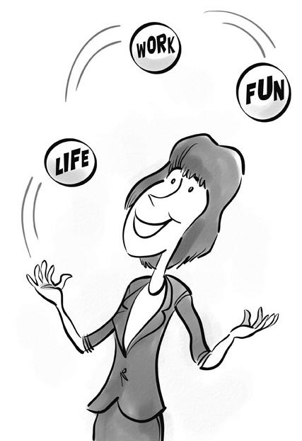
Litmus Test Question Four
Is the inquiry plan doable?

Slide 23
The action research process is definitely one that causes energy and excitement for many educators when they are given the opportunity to take charge of their own professional learning, sometimes for the first time since they entered adminstration!
This energy and excitement can sometimes lead to “Action Research Overboard Syndrome.” AR Overboard Syndrome occurs when an IPLI administrator gets so caught up in the possibilities when planning her research that the action research plan ends up resembling a plan for a doctoral dissertation or even an entire book!

Slide 24
Action researchers know that a certain amount of realism is an important ingredient to planning an inquiry.
Furthermore, action researchers have the potential to make real and lasting impact in their schools only when engagement in inquiry becomes a part of administrative practice, rather than exist apart from it.
Hence, a plan for action research must be doable and include the collection of reasonable amounts and reasonable types of data. Whenever possible, data collection strategies should emerge from what is a natural part of your work as a principal.

Slide 25
Before continuing with the litmus test, look carefully at your inquiry brief.
Is what you are planning reasonable to accomplish given all of the many responsibilities that are already a part of your work?
If not, work to downsize your inquiry and limit your inquiry goals and aspirations to something that is reasonable to accomplish.
Remember, inquiry is a cycle -- You don’t have to do everything in one pass through the cycle!

Slide 26

Litmus Test Question Five
Have you considered the possibilities of detours to your inquiry plan and built into your plan the flexibility necessary to take detours, if necessary, along the way?

Slide 27
Keep in mind that although you have utilized the first four inquiry brief litmus test questions to fine-tune the roadmap for your study, it is not uncommon for unexpected happenings to occur as your engage in the process of action research that may require you to take a detour from your plan.

Slide 28

While you really can’t plan for the unexpected, action researchers know that it is perfectly natural and normal to make shifts in plans as an inquiry unfolds.
Rarely does any inquirer
articulate a perfect
plan on paper that is tightly
constructed and plays out
exactly as originally planned
initially.

Slide 29
The value of the inquiry brief is not to create a perfectly articulated document that will play out exactly as planned, but to get something down on paper to get you started on the next leg of your inquiry journey.
As you begin to collect data and learn something that might shift the course of your journey, shift away!
Have the courage to take detours in your plan if what you are learning from your data indicates that it is desirable and necessary to do so.

Slide 30
Congratulations!
You’ve completed the Inquiry Brief Litmus Test!
On to data collection! Happy Inquiring!
Great Job!

