Slide 1
IPLI COHORT 8
2021 - 2022
Overview of IPLI Year 2
Notes:
Welcome to an overview of year 2 at IPLI. We are glad to share with you today the journey you will embark upon in Year 2.

Slide 2
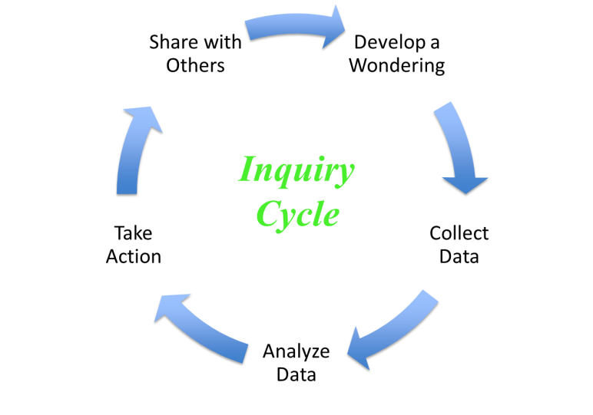
Year 1
Focus on Yourself
Using Inquiry Process
Year 2
Shift the Focus to Your School
Using Inquiry Process for School Improvement
Notes:
In year 1, the focus was on yourself and you used an action research process to increase your personal leadership capacity. In year 2, the focus shifts to your school and with your two teacher leaders, you will use the AR process to develop a project to increase the learning capacity of your school.

Slide 3
Mission
The mission of the Indiana Principal Leadership Institute is to provide building-level principals with the skills and tools needed to increase their personal leadership capacities, as well as to increase the learning capacities of their schools.
Notes:
The IPLI mission statement is stated to include both years of professional development work and guides us incrementally to embed this learning into our field.

Slide 4
at seminar
Faculty Commitment, Identify Limitations, Promises and Obligations, Identify External Support, Examine Learning Capacity – Set/Revise Goals.
SCHOOL ASSESSMENT
REFLECTION
YEAR 2
CREATE/REVISE SCHOOL IMPROVEMENT PLAN
YEAR 1
TEAM ACTION RESEARCH
SCHOOL CAPACITY
away from seminar
NEXUS
collect, analyze data
practice
collect, analyze data
practice
reflect, make adjustments
reflect, make adjustments
PERSONAL CAPACITY
away from seminar
SELF ACTION RESEARCH
CREATE/REVISE LEADERSHIP CAPACITY PLAN
Personal Commitment, Identify Limitations, Promises and Obligations, Identify External Support, Examine Leadership Capacity – Set/Revise Goals.
SELF ASSESSMENT
REFLECTION
at seminar
Notes:
This is the model we shared with you last July and now we are moving to the top of the model and following a similar AR process as year 1.

Slide 5
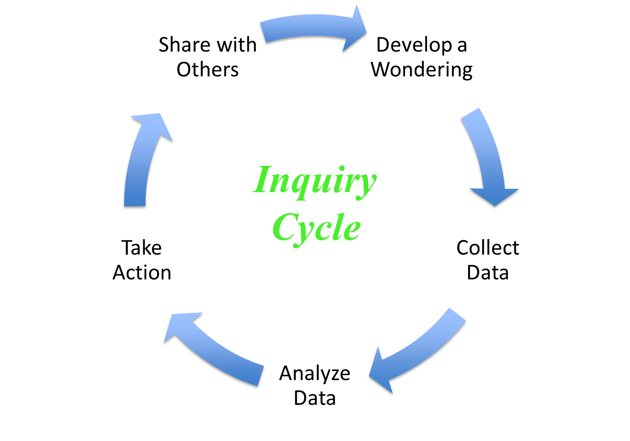
Year 2
Focus now shifts to your school
2 teacher-leaders join you
Wondering – How do we improve the learning capacity of our school?
Notes:
As stated before, the focus now shifts to your school. You will have two teacher leaders that you select from your school to work with you to develop a research project that will improve the learning capacity of your school.

Slide 6
We will collect and analyze data:
State assessments or formative assessments such as NWEA
Perception data (e.g., school culture survey, HRS data, accreditation data such as AdvancEd)
Behavior data (e.g., attendance rates, PBIS data, discipline data)
Program data (e.g., a specific reading, writing, or math program)
Etc.
Notes:
In order to study your school, you and your school team will analyze existing school data such as state assessments like ILEARN, IREAD or formative assessments like NWEA, i-Ready or Study Island that you already have in place. Maybe your school district has collected perception data through accreditation. You should have behavior data that you utilize to inform practices and possibly some program data such as Dreambox or Lexia for reading and math.

Slide 7
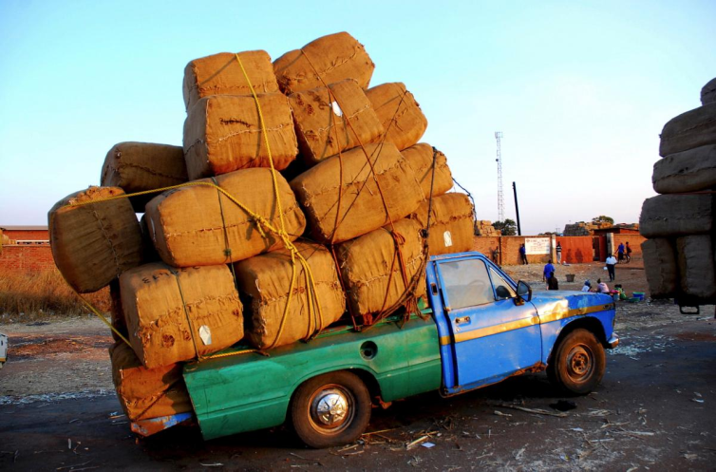
Schools are suffering from:
DRIP Syndrome: Data Rich, Information Poor
Numerous New Initiatives
Changing Assessments
Changing Accountability
Etc., Etc., Etc.
Notes:
If you are like most schools, you may be suffering from the DRIP Syndrome (Data Rich and Information Poor). With all the data at our fingertips and then adding on things like new initiatives, changing assessments and accountability models, not to mention things like redistricting or a pandemic, you may feel much like the truck in the photo….always climbing with a large load on your shoulders.

Slide 8
Accreditation
District Plan
Others???
Notes:
And then there are other layers such as accreditation or district plans that must be adhered to or developed.

Slide 9
Notes:
One of the keys to improving our schools is effective use of data. While the data can be overwhelming, one of our goals at IPLI is to assist you in making sense of all this data and to help you focus on the right work for your school.

Slide 10
High Reliability Schools™
“…take proactive steps to prevent failure and ensure success.”
“…monitor the effectiveness of critical factors within the system and immediately take action to contain the negative effects of errors that occur.”
A Handbook for High Reliability Schools by Marzano, Warrick, and Simms
Notes:
In IPLI, we use the High Reliability Schools improvement framework to study our schools. High Reliability Schools take proactive steps to prevent failure and ensure success.

Slide 11
High Reliability Schools™ Framework
What it is not…
What it is…
It is not an accreditation model.
It does not replace your current accreditation model.
It does not replace your district’s school improvement process.
It is a way to focus our work in schools. Where do we start?
It is based on research.
The surveys are another set of data to help us understand where to “focus” our work.
It provides the “how to do it” component missing from many frameworks.
Notes:
We want to be clear about the use of the High Reliability Schools framework in IPLI in terms of what it is and what it is not. HRS is not an accreditation model and it does not replace your district model. It also does not replace your district or school improvement process. But what it does do is to give you a way to focus on work in school. It helps us determine where we start. It is research-based and it can be a crosswalk with any of the other school models out there. We will be asking you to administer HRS surveys as another set of data to help you and your team understand where to focus your work. It provides the “how to” component that is often missing from any framework.

Slide 12
Hierarchy of School Factors
Safe & Collaborative Culture
Effective Teaching in Every Classroom
Guaranteed & Viable Curriculum
----------------------------------------------------------
Standards-Referenced Reporting
Competency-Based Education
Notes:
This summer, Dr. Tammy Heflebower from Marzano Research will walk you through the HRS framework. The HRS framework is a hierarchy of school factors that research has shown significantly impacts student achievement. In IPLI, we are only focusing on the first 3 factors, 1. Creating a Safe and Collaborative Culture, 2. Effective Teaching in Every Classroom, and 3. a Guaranteed & Viable Curriculum. Research has shown that if you can get these first 3 factors in place, your school will see dramatic results.

Slide 13
HRS Surveys
Safe & Collaborative Culture – Level 1
Administer: April/May
Results: July Seminar
Effective Teaching in Every Classroom – Level 2
Administer: July/August
Results: September Seminar
Guaranteed & Viable Curriculum – Level 3
Administer: October/November
Results: January Seminar
Notes:
We will be asking you to administer a series of HRS surveys to gather data from your school. So here is our timeline. For Level 1, we will be distributing the link to these surveys to you at the conclusion of the April Seminar. We set everything up for you and then you send these out to your stakeholders and the data will be collected through our Qualtrics system. Pretty easy to do. You will receive a report at the Summer Seminar that will give you data to study to begin work on your wonderings for your school team project. Level 2 surveys will go out after the July seminar with results to you in September and Level 3 surveys will go out after the September Seminar with results back to you in January.

Slide 14
SURVEYS
Required
Administrators
Teachers
Administer during a staff meeting where you have a captured audience. Principal should step out during administration.
Optional for Level 1
Students (upper elementary, middle, and high school)
Parents
Notes:
As for the surveys, if you are already a certified HRS school and your surveys are current, we would not ask you to re-administer these surveys. If you are not an HRS school, we are asking that you administer the surveys to your administrators and teachers. To gain further insight with your data for Level 1, you might consider asking your students and parents to also take the surveys. This will provide you with more feedback to support your data collection in looking at your school culture. Levels 2 and 3 are for teachers and administrators only.

Slide 15
DATA
For use by your Team during Year 2
You/Team decide if you want to share with others in your school/district (highly encouraged)
IPLI – no names attached to data
Notes:
For each HRS survey, IPLI will compile each school’s results into a report of your data for you and your team to analyze. We do not share the report with others. As a team, you decide if you want to share the results with your school and/or your district. IPLI does gather the data about the schools, but no names are attached to this data.

Slide 16
Year 2
Teachers will attend seminars with you.
Teachers will have a special session at some of the seminars to allow our principals to work with our mentors.
Time to work together as a school team.
Notes:
During Year 2, your teachers will attend the seminars with you. IPLI will provide special sessions for the teachers at some of the seminars so principals can work with their mentors. But time will be set aside during the seminars to work together as a school team. Our speakers from Marzano Research will not only show you how to do it, but they give you time to analyze the data and consider your next steps as a team. Remember, the IPLI goal is to expose you to some great ideas, speakers and resources. Your journey with us is to grow your practice and your school.

Slide 17
2021 Summer Seminar Bring 2 Teacher-Leaders with You
Wednesday, July 7, 2021
Thursday, July 8, 2021
David Simpson, Five Dysfunctions of a Team and The Six Genius Types for Teams
Kim Campbell – Motivating the Middle
Tammy Heflebower, Marzano Research:
(HRS 1) The Journey to Becoming a Professional Learning Community
Notes:
Cohort 8 will kick off Year 2 of IPLI at the 2-day 2021 Summer Seminar on the ISU campus. On Day 1, David Simpson from the Patrick Lencioni Group will be with us to talk about the Five Dysfunctions of a Team. We will explore the Table Groups “Six Genius Types” for teams. Kim Campbell, a real live practicing middle school teacher with a great sense of humor will share some insights with us as well. On Day 2, Dr. Tammy Heflebower will take you on the journey to learn about HRS Level 1, A Safe and Collaborative Culture through Becoming a Professional Learning Community. We will enjoy learning together and some socially distanced fun as we gather together for these 2 great days. You and I will get to experience what all the other IPLI Cohorts have experienced and that is the summer seminar together in person on the ISU campus!

Slide 18
2021-2022 Seminars
Tuesday, September 21, 2021 – Principals & Teacher-Leaders
Sunday, November 21, 2021 – Principals Only
Monday, November 22, 2021 - Principals Only
Tuesday, January 25, 2022 – Principals & Teacher Leaders
Tuesday, April 12, 2022 - Showcase of Schools & Graduation – Principal & Teacher-Leaders
***Regional Focus-Cohorts (principals and mentors) continue to meet in August, October, February, March, May/June
Notes:
Here are the dates of all of the Year 2 Seminars. September, January, and April will be held at the Lawrence Township Educational Center in Indianapolis. The November Seminar will be in conjunction with the IASP Fall State Professionals Conference in Indianapolis. Make sure you have these dates marked in your calendars for you and your teacher-leaders.

Slide 19
Notes:
Before we introduce our afternoon speaker, let’s take a quick stretch break for about 15 minutes. This is a great time to refill your drinks or take a RR break. See you back in 15!

Slide 20
School Culture
with
Dr. Steve Gruenert
Notes:
Today, you have received the results of the Culture Survey that you had your school participate in this winter. Here to share more about school culture and to touch a bit more on the selection of your teacher leaders is our keynote speaker for today. Dr. Steve Gruenert is a professor here at Indiana State University. He has studied organizational culture and climate for more than 20 years and continues to learn and collaborate with other researchers as these concepts evolve. He is a nationally and internationally known expert on school culture.
Dr. Gruenert is the coauthor of School Culture Rewired: How to Define, Assess, and Transform It (ASCD), and Minds Unleashed: How Principals Can Lead the Right-Brained Way. Dr. Gruenert is the mastermind behind the inception of IPLI serving on the Design Team and the Leadership Team. Ladies and Gentlemen, please welcome our friend and colleague, Dr. Steve Gruenert.

Slide 21
Notes:
Thank you for a great day together. Looking forward to Year 2 with you in person! See you this summer!

